Slide 1
AXI VIP
Prepared By : Shravya Samala
Email : shravyasamala89@gmail.com
LinkedIn : https://www.linkedin.com/in/samalashravya
GitHub : https://github.com/ShravyaSamala

Slide 2
AXI Introduction
AXI, or Advanced extensible Interface, is a high-performance interface protocol developed by ARM for connecting components in System-on-Chip (SoC) designs. It is part of the AMBA (Advanced Microcontroller Bus Architecture) specification, which aims to standardize communication between various blocks in a chip.

Slide 3
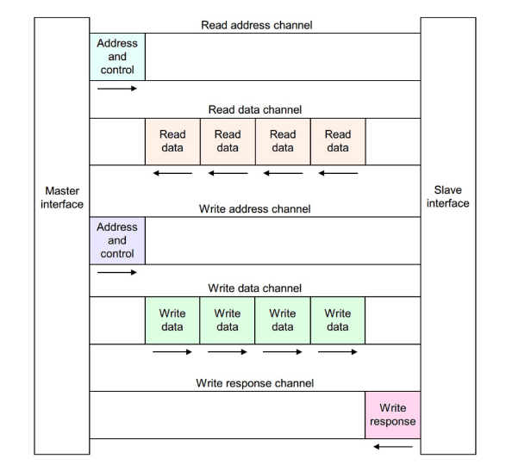
Overview of AXI
The AXI utilizes dedicated channels for data, address, and control signals to facilitate efficient communication between masters and slaves.
Write Address Channel
Write Data Channel
Write Response Channel
Read Address Channel
Read Data/Response Channel

Slide 4
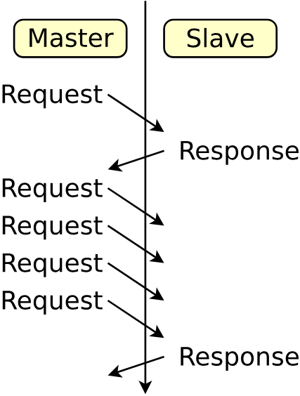
Key Features of AXI
Burst based transaction with start-address
Five channel Architecture
Multiple outstanding Addresses(Multiple request)
Separate channel for read and write operations
Aligned and Non-Aligned Address support
Higher Bandwidth

Slide 5
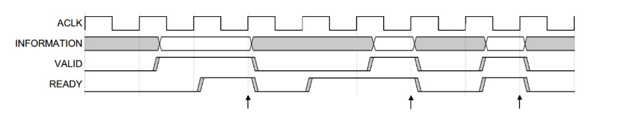
Handshake Mechanism
VALID: Indicates that the sender (master or slave) has valid data or an address to send.
READY: Indicates that the receiver (slave or master) is ready to accept data or the address.
The data transfer happens only when both the VALID and READY signals are asserted (set to high).

Slide 6
AXI Signals
WRITE ADDRESS
CHANNEL
WRITE DATA
CHANNEL
WRITE RESPONSE
CHANNEL
READ ADDRESS
CHANNEL
READ DATA
CHANNEL
AWID
AWVALID
AWADDR
AWREADY
AWBURST
AWSIZE
AWLEN
RID
RVALID
RDATA
RREADY
RRESP
RLAST
WID
WVALID
WDATA
WREADY
WSTRB
WLAST
BID
BVALID
BRESP
BREADY
ARID
ARVALID
ARADDR
ARREADY
ARBURST
ARSIZE
ARLEN

Slide 7
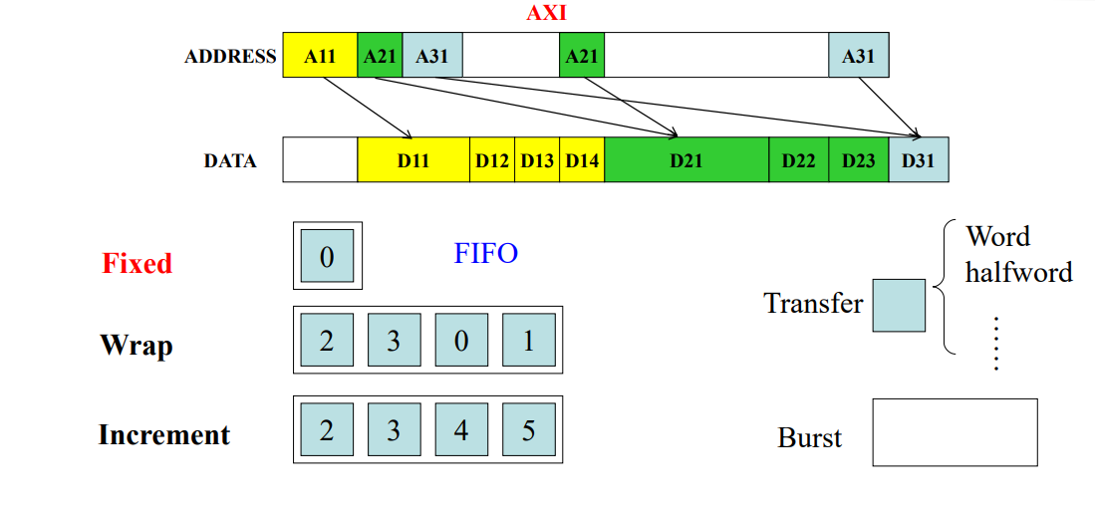
AXI Burst Transfer
AXI supports burst transfers, which allow for multiple data transfers with a single address and control signal, reducing overhead and enhancing efficiency
FIXED LENGTH
Fixed length burst transfer a predefined Number
Data words
INCREMENT
Increment burst transfer data words at sequential addresses
WRAP
Wrap burst transfer data words with Addresses
That wrap around a defined boundary

Slide 8
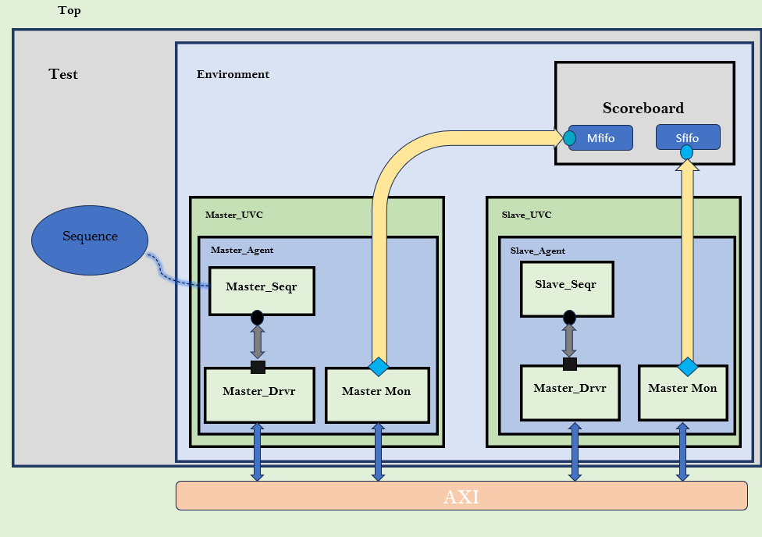
TB Architecture

Slide 9
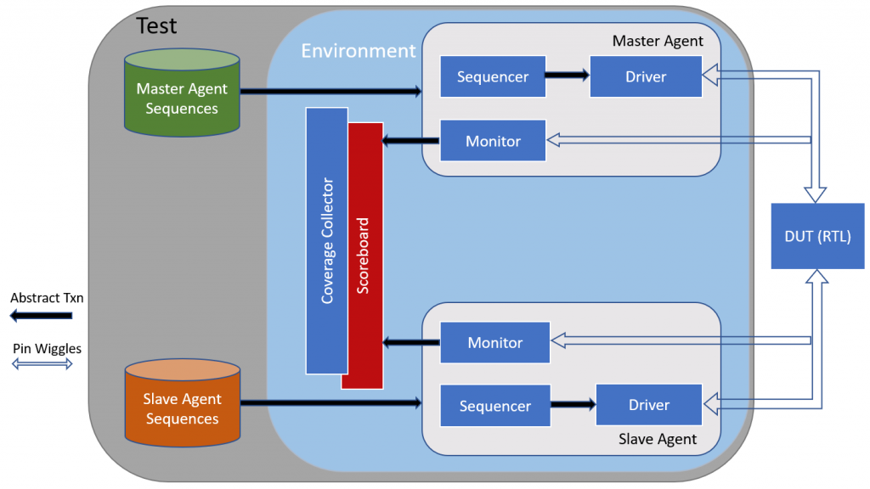
Scoreboard

Slide 10
Conclusion
AXI verification is critical for ensuring high-performance and reliable data transfer in SoCs.
Using UVM, System Verilog, and industry-standard tools helps achieve thorough verification and high functional coverage.
Robust AXI verification is essential for meeting the demands of modern digital systems

Slide 11
Thank You
Any Questions?

